Slide 1
Advanced Angular
Template-driven Forms
Lecture 5
By James(Jin) Wang
11/15/2021

Slide 2
Outline
Implement forms with different kinds of input fields
Display validation errors
Disable the submit button

Slide 3
Building a Bootstrap Form
  Bootstrap Form:
  ng g c contact-form

Slide 4
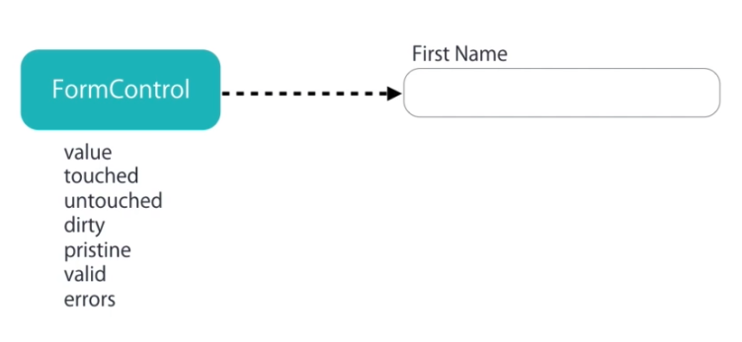
Building a Bootstrap Form
  Types of Forms:

Slide 5
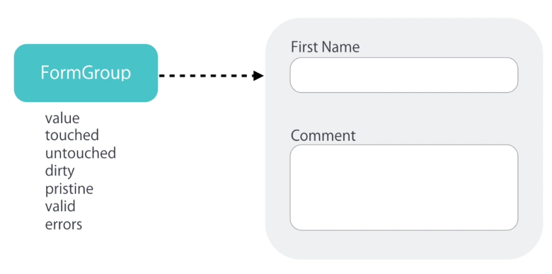
Building a Bootstrap Form

Slide 6
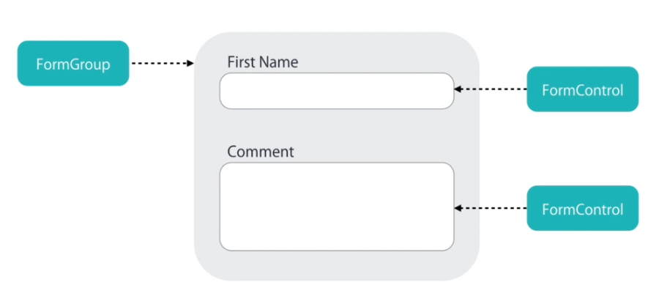
Building a Bootstrap Form

Slide 7
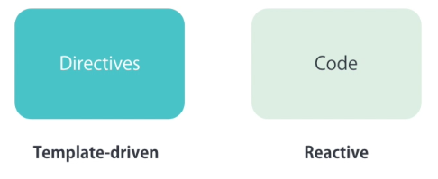
Building a Bootstrap Form
  Creating Controls:

Slide 8
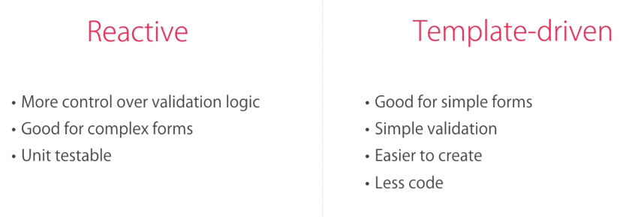
Building a Bootstrap Form
  Types of Forms:

Slide 9
Building a Bootstrap Form
  ngModel:
  add:
  <input ngModel name="firstName" #firstName="ngModel" (change)="log(firstName)" id="firstName" type="text" class="form-control">

Slide 10
Building a Bootstrap Form
  Adding Validation:
  add:
  <div class="alert alert-danger" *ngIf="firstName.touched && !firstName.valid">First Name is required!</div>

Slide 11
Building a Bootstrap Form
  Specific Validation Error:
  add:
  <input required minlength="4" maxlength="10" pattern="banna" ngModel name="firstName" #firstName="ngModel" (change)="log(firstName)" id="firstName" type="text" class="form-control">

Slide 12
Building a Bootstrap Form
  Styling Invalid Input Fields:
  add:
  .form-control.ng-touched.ng-invalid {
  border: 2px solid red;
  }

Slide 13
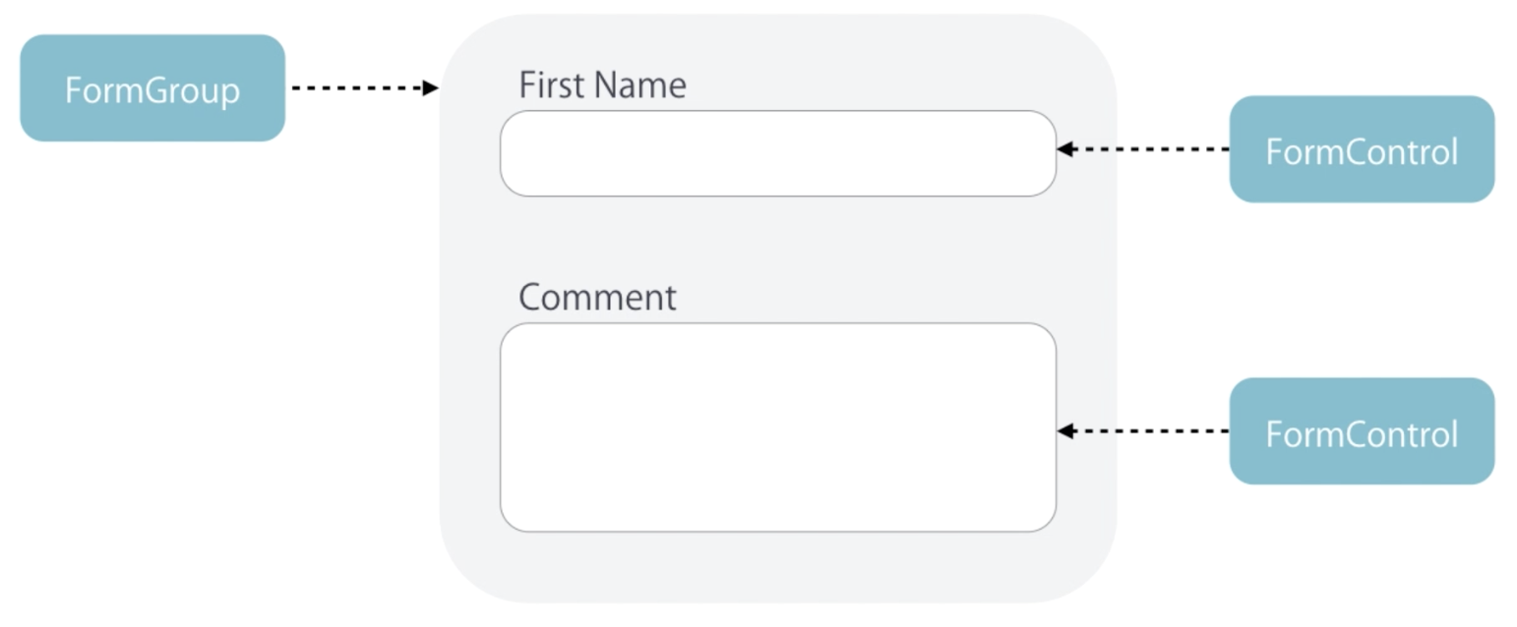
Building a Bootstrap Form
  ngForm:

Slide 14
Building a Bootstrap Form
  ngForm:
  add:
  <form #myform="ngForm" (ngSubmit)="submit(myform)">

Slide 15
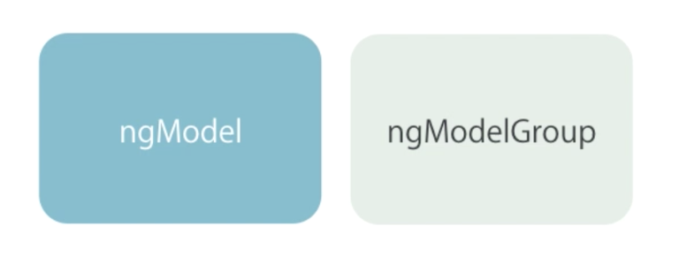
Building a Bootstrap Form
  ngModelGroup:
  add:
  <div ngModelGroup="contact">

Slide 16
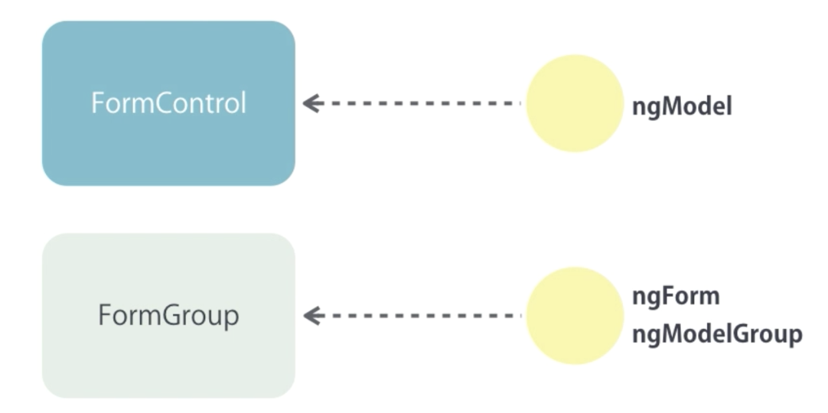
Building a Bootstrap Form
  Control Classes and Directives:

Slide 17
Building a Bootstrap Form
  Disabling the Submit Button:
  add:
  <button class="btn btn-primary" [disabled]="!myform.valid">Submit</button>

Slide 18
Building a Bootstrap Form
  Working with Check Boxes:
  add:
  <div>
  <label>
  <input type="checkbox" ngModel name="isSubscribed"> Subscribe to mail
  </label>
  </div>
  <p>{{ myform.value | json }}</p>

Slide 19
Building a Bootstrap Form
  Working with Drop-down Lists:
  add:
  <div class="form-group">
  <label for="contactMethod">Contact Method</label>
  <select ngModel name="contactMethod" id="contactMethod" class="form-control">
  <option *ngFor="let method of contactMethods" [value]="method.id">{{ method.name }}</option>
  </select>
  </div>

Slide 20
Building a Bootstrap Form
  Working with Radio Buttons:
  add:
  <div *ngFor="let method of contactMethods" class="radio">
  <label>
  <input ngModel type="radio" name="contactMethod" [value]="method.id"> {{ method.name }}
  </label>
  </div>

Slide 21
Summary

